Slide 1
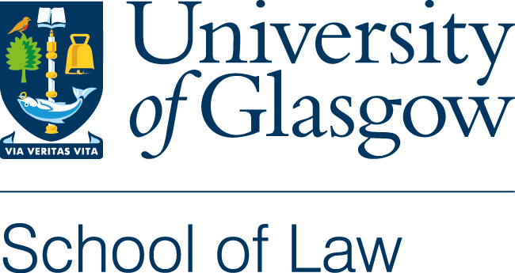
AI Governance and AI Value Chains
Alessio Azzutti
Lecturer in Law & Technology (FinTech)
University of Glasgow
Faculty of Law
LLM Artificial Intelligence & Law
Seminar 9
18 March 2026

Slide 2
Seminar Outline
Recap of Previous Seminar
AI Value Chains: The Inter-Organisational Dimension of AI Governance
AI Value Chains and Emerging AI Regulations
In-Class Activity

Slide 3
Part One
Recap of Seminar 8:
AI Governance and the AI Lifecycle

Slide 4
Key Questions We Got Started With
What is meant by AI Governance?
Why do we need it?
And who should be in charge of it?

Slide 5
Key Topics Covered
🧩 Organisational AI Governance
Understanding AI governance at the organisational level, rather than at the project or application level.
Core principles and frameworks.
🔄 The AI Lifecycle
The phases and sub-phases of an AI project, from conceptualisation to operation.
How governance (and regulatory) requirements are embedded across the different stages of the AI lifecycle.
⚖️ Relevance for AI Regulation (AI Act as Case Study)
The challenge of translating legal principles into practice.
Mapping regulatory obligations across AI lifecycle stages.
Ongoing challenges and emerging regulatory frameworks.

Slide 6
Group Activity
The AI Lifecycle as a Regulatory concept
Work in groups of 3-4 students.
Consider the lifecycle of a large generative AI system such as ChatGPT (e.g., data collection, model development, deployment, and monitoring).
Your Tasks
1. Reflect
Why might a lifecycle approach be useful for regulating and governing such AI system?
2. Apply regulatory theory
How does public regulation theory justify regulating the AI lifecycle?
How does private regulation theory explain the lifecycle’s governance role?
3. Debate
Should regulation of the AI lifecycle rely more on principles or on detailed rules?
📌 Prepare a short reflection to share with the class.

Slide 7
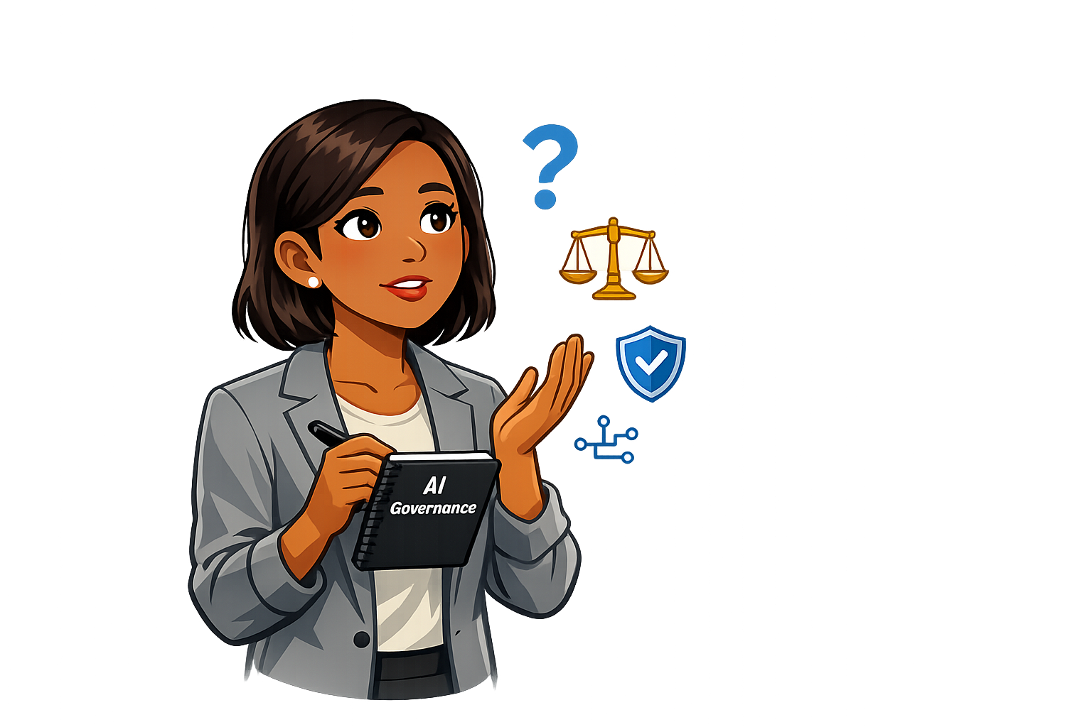
Questions?

Slide 8
Part Two
AI Value Chains

Slide 9
Our Guiding Questions Today
Where do accountability and responsibility lie when multiple actors contribute to an AI application?
How do regulatory frameworks address risks arising from coordination among multiple actors?
What are the key challenges in governing complex AI value chains that span multiple jurisdictions with inconsistent regulatory standards?

Slide 10
The AI Value Chain and AI Governance
Cf. Engler & Renda (2022); Cobbe, Veale, & Singh (2023)
🌐 What is the AI Value Chain?
A network of interdependent actors extending beyond a single organisation and involved in the design, development, deployment, and operation of AI systems.
⚖️ Why Is It Relevant for AI Governance?
Defines Stakeholders Roles & Responsibility – AI governance cannot focus on a single entity, such as the provider or deployer. Each actor in the AI value chain, including data providers, model developers, deployers, and end users, has distinct responsibilities.
Links Regulations to Specific Actors – AI-related regulations, such as the AI Act, impose different obligations at different stages of the value chain, for example on high-risk AI providers, deployers, and users.
Enhances Risk & Compliance Management – AI risks, including bias, safety, and opacity, may arise at different stages and therefore require coordinated governance across all involved entities.
Promotes Trustworthy AI – A well-governed AI value chain helps ensure alignment with organisational goals, ethical principles, and regulatory requirements.

Slide 11
AI Lifecycle vs. AI Value Chain
Cf. Engler & Renda (2022: 2)
🔄 AI Lifecycle – Network dynamics between organisational actors
The key issue is addressing technical and governance challenges at each stage while ensuring coherence and integration across the lifecycle. This is primarily an intra-organisational issue, as the focus is on how AI systems, as socio-technical systems, are developed within an organisation.
🌐 AI Value Chain – Network dynamics between market actors
The key issue is defining clear responsibilities, obligations, and compliance requirements across the multiple actors involved in the production and deployment of AI. This is necessarily an inter-organisational issue, as it requires coordination and alignment across different business entities and, in some cases, end users.
🧩 Are the two concepts related? In what way?

Slide 12
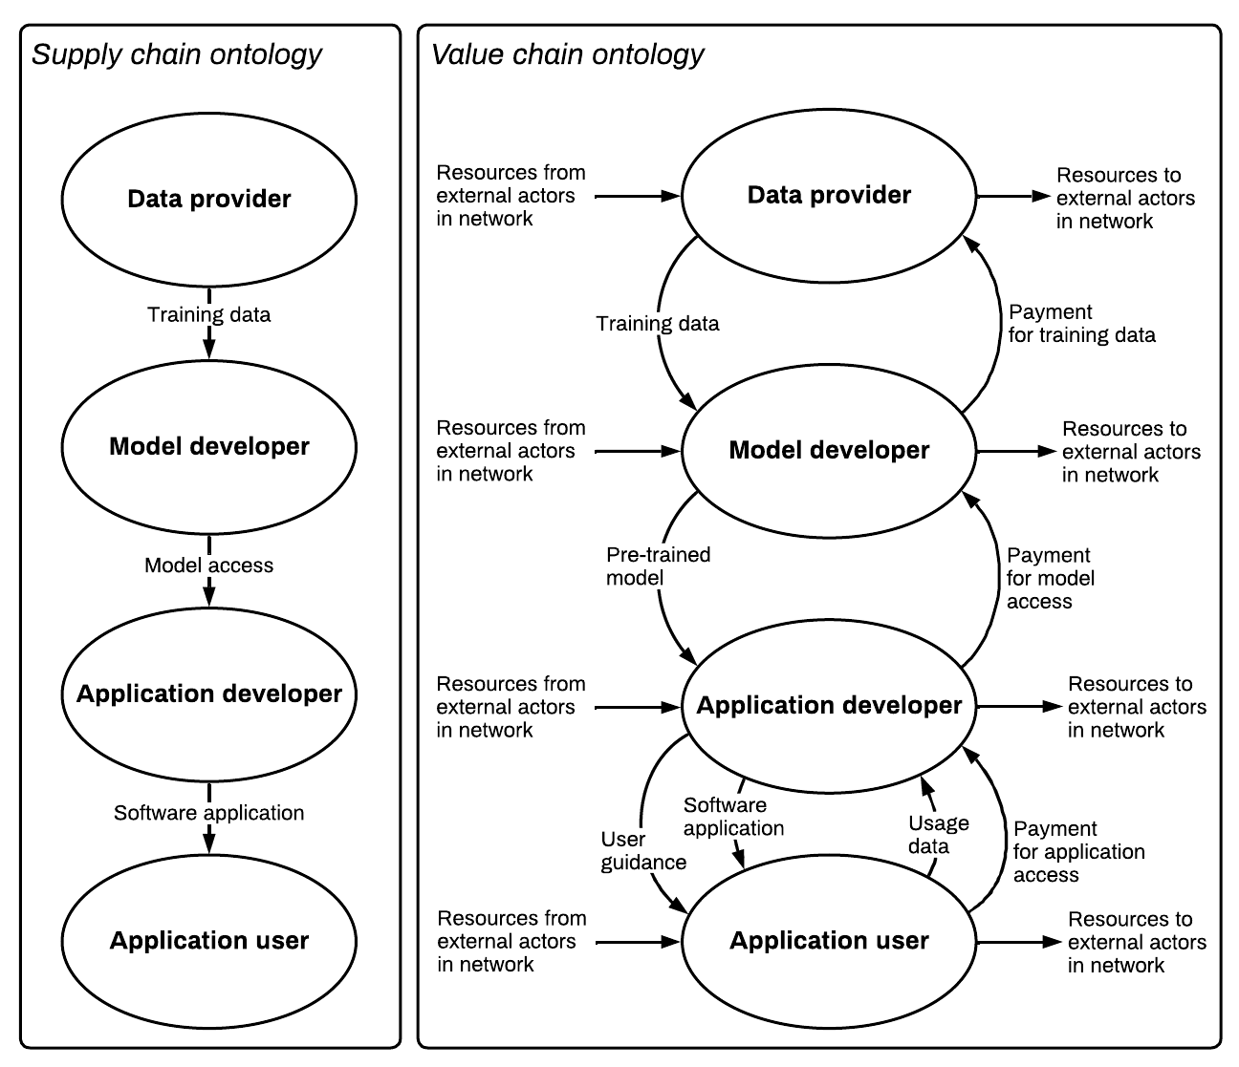
Supply Chains vs. Value Chains
Value chains are more “complex” systems than supply chains.
🔗 Supply chains
Represent linear, vertical flows of production and consumption.
Resources, goods, and services move downstream from raw materials to the end user/consumer.
Focus on efficiency, logistics, and cost reduction in delivering a final product.
🌐 Value chains
Represent multi-directional, co-creative relationships across different actors.
Resources, knowledge, and innovation are integrated upstream, downstream, and horizontally within a broader value network.
Focus on value creation, differentiation, and competitive advantage through strategic interactions.

Slide 13
Examples of Value Chain Actors
📊 Data & Input Providers
🏢 Training Data Centres – Provide infrastructure for large-scale AI model training.
🗂️ Data Brokers & Sources – Supply raw data, often aggregated from multiple sources.
📝 Labelling / Annotation Firms – Process and curate datasets for supervised learning.
🛠️ Model Development & Fine-Tuning
🧠 Foundation Model Developers – Build and pre-train large AI models.
🎯 Fine-Tuning Providers – Customise and adapt models for specific use cases.
💻 Model Hosting & Deployment
☁️ Model Hosting Platforms – Provide cloud-based or local infrastructures for model access.
📱 Querying Data Centres or Consumer Devices – Enable model inference and user interactions.
🏗️ Downstream Users & Integrators
📲 AI Application Developers – Build AI-powered software and solutions.
🏛️ Business & End-User Implementers – Organisations and individuals making use of AI tools.
⚖️ Regulators & Auditors – Enforce regulatory requirements and ensure governance.

Slide 14
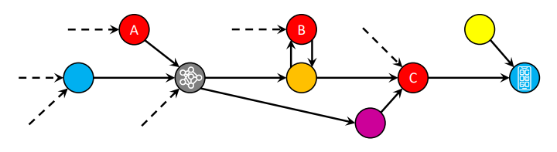
AI Governance Challenges along Value Chains
See Cobbe, Veale, & Singh (2023: 1190)
Production, deployment, and use are often distributed across multiple actors.
Interdependent actors must work together to enable AI functionality.
Errors, biases, and failures can propagate throughout the value chain, amplifying risks.
Value chains may be assembled as needed and can differ from one case to another.
Vertical and horizontal integration can create systematically important actors.
Future trends may drive greater market concentration, with AI as a service (AIaaS) emerging as the dominant business model.

Slide 15
Consequences for Illegal or “Problematic” Uses
Cf. Perrow (1999)
⚠️ Multiple regulatory access points exist, but not all are effective, consistent across jurisdictions, or durable, especially when relied on in isolation.
⚠️ Failures and risks can arise from multiple sources along the AI value chain.
Tightly coupled, fast-moving, and complex AI systems are inherently prone to unexpected failures, as suggested by Perrow’s Normal Accident Theory.
⚠️ Value chains can be structured to minimise costs and shift accountability, creating significant governance challenges.
Hence: Are AI value chains themselves governable or regulable?

Slide 16
Practicing with an example
⚠️ Scenario: AI-Powered Hiring Tool
A company develops an AI-based recruitment system, but its value chain involves multiple actors:
📊 Data Provider – Supplies training data, but data quality may be flawed (e.g., biased, incomplete).
🧠 Model Developer – Provides a pre-trained AI model but takes no responsibility for its use.
☁️ Cloud Provider – Hosts and deploys the model but only provides infrastructure, not oversight.
🔍 The Problem:
The AI system discriminates against certain job applicants.
💡 Key Questions for Discussion
Who is accountable? The employer? The model developer? The data provider?
Where may governance gaps emerge in this value chain?
How could or should AI regulation address these challenges?

Slide 17
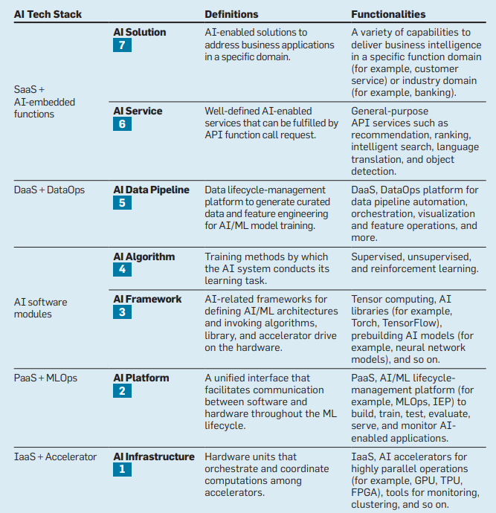
The AI Tech-Stack Model
Source: Tsaih, Chang, Hsu, & Yen (2023)
The AI Tech-Stack Model is composed by seven layers. It is intended as a normative framework for dealing with the management and technology challenges inherent to AI adoption.
“The model offers a layered architecture to help executives understand which layer might best fit a specific vendor’s AIaaS offerings and (…) differentiate among multiple vendors’ offerings (…) [It] also enables executives to reduce/decompose (…) challenges to the layer perspective so that interoperability and reliability are further enhanced.” (p. 71)

Slide 18
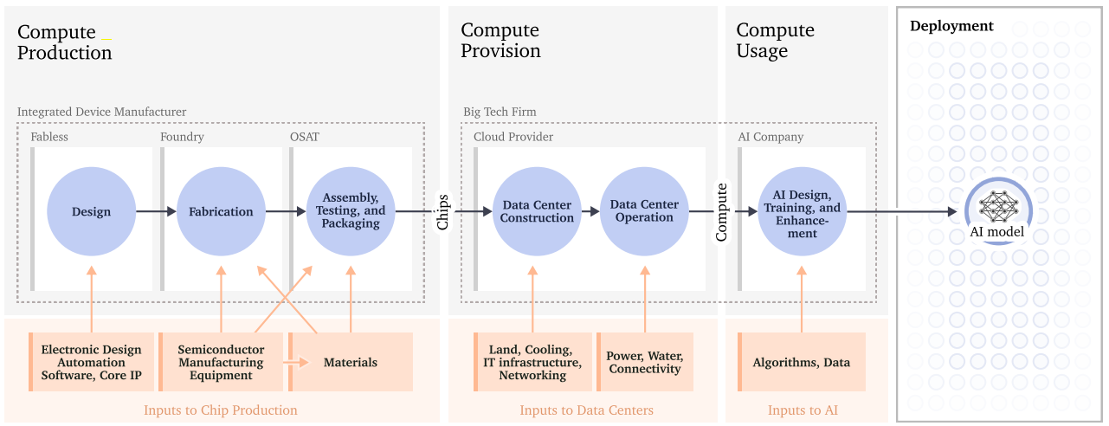
The Compute Value Chains
Source: Sastry et al. (2024: 30)

Slide 19
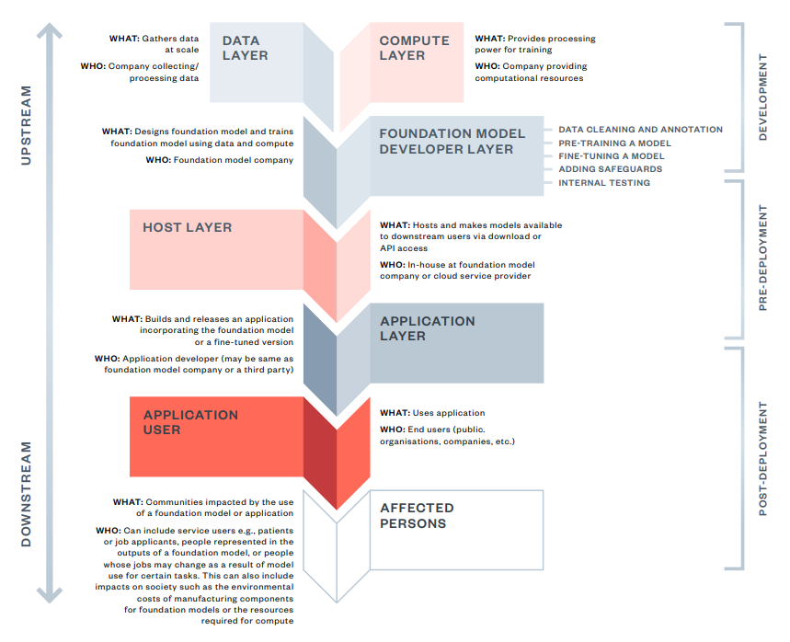
The Foundation Model Value Chain
Source: Dunlop & Ghani (2024)

Slide 20




High-Level View of the GenAI Value Chain
As Interwoven with the AI Lifecycle
Develops
Foundation model
Customise Foundation model to suit a given use case
Further fine-tuning of the model
Use of AI tool
Hyperscale technology firm
Tech provider
(deployer one)
Corporate User
(deployer two)
Employees of deployer two
Source: The Institute of International Finance (2024: 8)

Slide 21
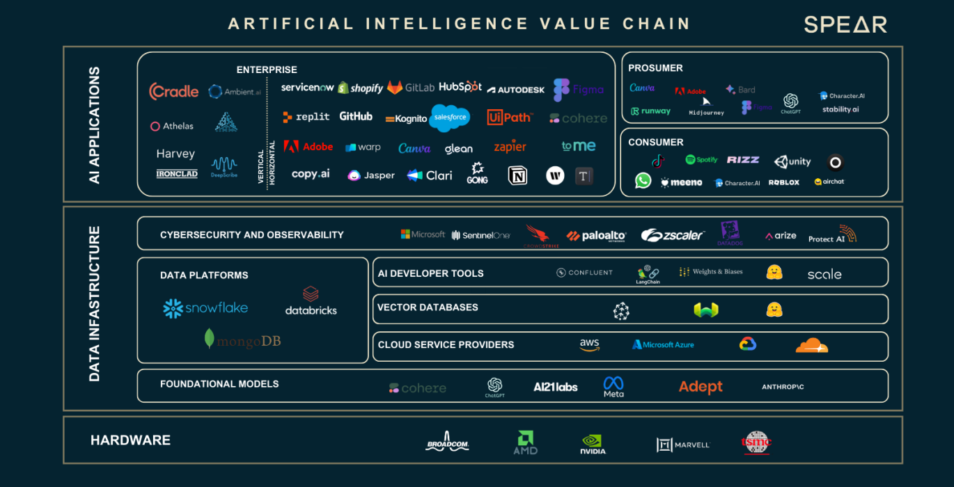
Source: Nasdaq (2023)

Slide 22
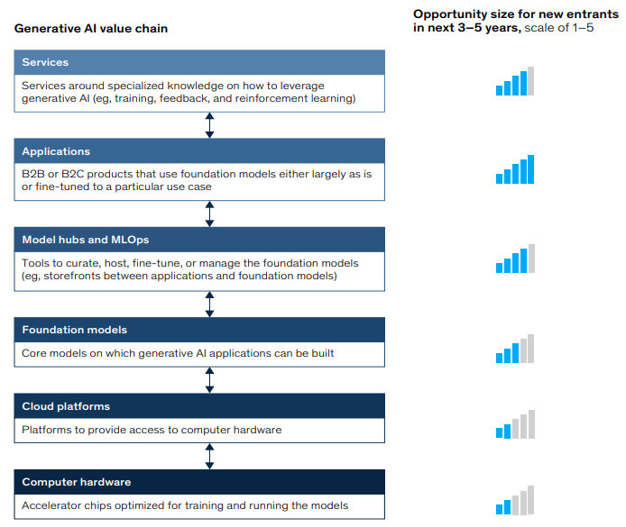
Generative AI Value Chain
Source: McKinsey (2023: 3)

Slide 23
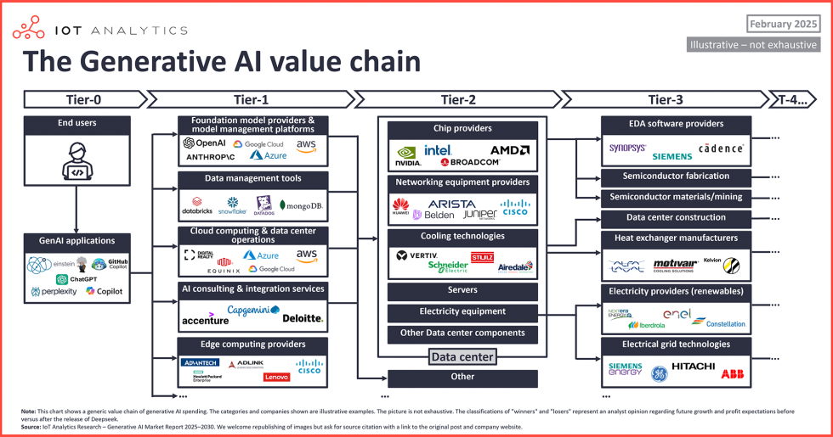
DeepSeek vs. ChatGPT
Under an AI value chain perspective
Source: Wegner (2025)

Slide 24
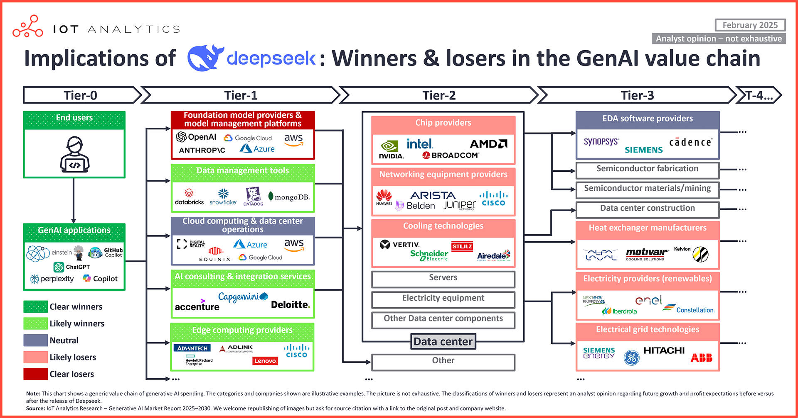
DeepSeek vs. ChatGPT
Under an AI value chain perspective
Source: Wegner (2025)

Slide 25
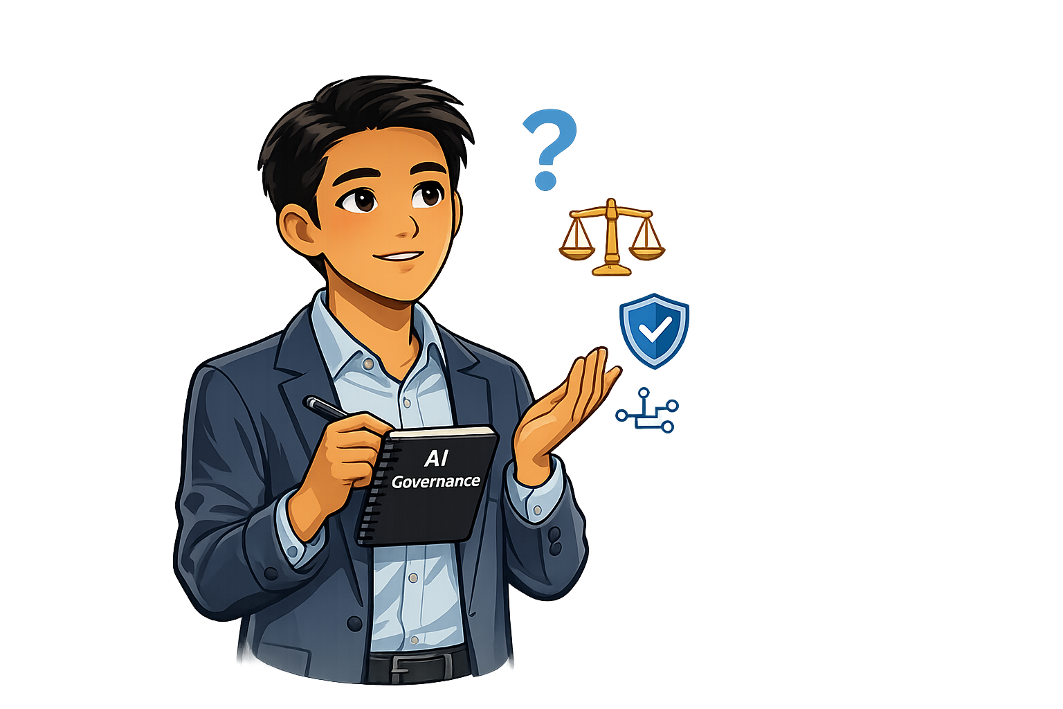
Questions?

Slide 26
Part Three
AI Value Chains and AI Regulations

Slide 27
Mapping the AI Act into AI Value Chains
The AI Act mentions the term “AI value chain” 18 times:
(I) Value Chains & Complexity 🌐
Recital (9) – Regulatory complexity implications for AI value chains governance.
Recital (83) – The multi-actor nature of AI value chains and the challenges in defining roles.
Art. 66(e)(vi) – Evolving AI value chain typologies and related accountability challenges.
(II) Actors’ Roles Along the AI Value Chain 👥
Recital (20) – AI literacy for all actors in the value chain.
Recital (85) – GPAI providers’ responsibilities in high-risk AI applications.
Recital (88) – AI resources providers’ responsibilities towards high-risk AI providers.
Recital (89) – Issue of trustworthiness of third-party open-source AI resources.
Recital (101) – Key role of GPAI models providers in AI value chain governance.
Recital (109) – Obligations for providers regarding downstream modifications to GPAI models.
Art. 25 – “Responsibilities along the AI value chain” for distributors, importers, or other third-party.

Slide 28
Mapping the AI Act into AI Value Chains (ii)
(III) Other Governance Requirements
Recital (90) – EU Commission’s power to develop voluntary model contractual terms to support AI value chain governance.
Recital (114) – Cooperation requirements across the AI value chain for systemic risk GPAI models.
Recital (135) – Transparency requirements for AI-generated content and cooperation mechanisms among relevant actors.
Art. 3(65) – Definition of systemic risk GPAI models and their value chain aspects.
Art. 56(2)(d) – Link between AI value chains and future establishment of “codes of practice” for providers of systemic risk GPAI models.

Slide 29
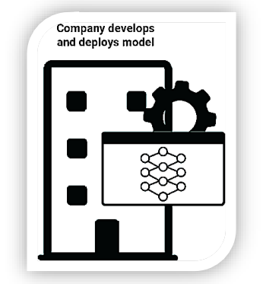
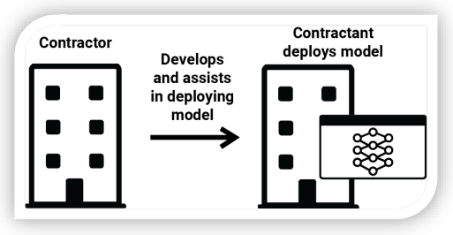
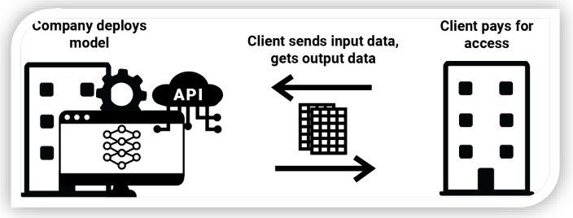
A Typology of AI Value Chains
Source: Enger & Renda (2022)
NB: A typology like the one proposed by Enger & Renda (2022) can help identify which actors along the AI value chain fall under the AI Act’s requirements for “providers” and “deployers”.
Type 1
Type 2
Type 3
In-house development
AI system contracting
Restricted AI system access

Slide 30
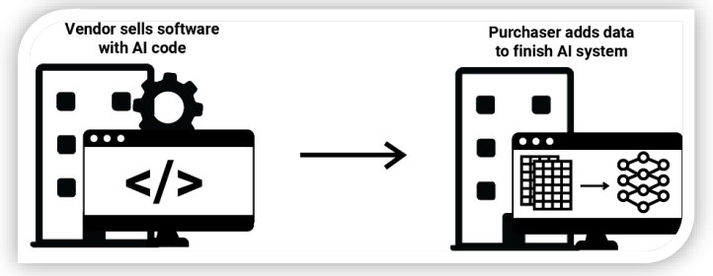
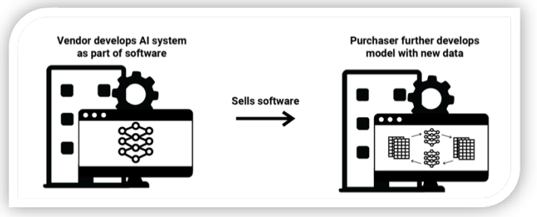
A Typology of AI Value Chains (i)
Source: Enger & Renda (2022)
Type 4
Type 5
Software with AI code
Vendors of learning AI systems

Slide 31
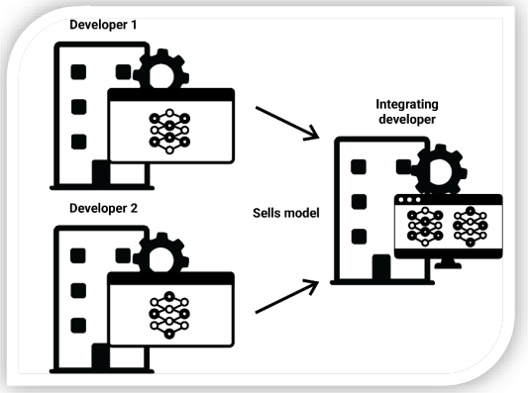
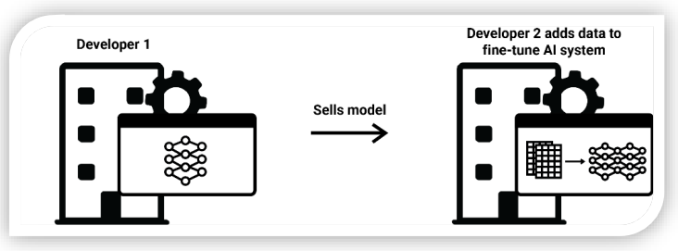
A Typology of AI Value Chains (i)
Source: Enger & Renda (2022)
Type 7
Type 6
AI system fine-tuning
AI model integration

Slide 32

Questions?

Slide 33
Part Four
In-Class Activity

Slide 34
In-Class Activity
The AI Value Chain as a Regulatory Concept
🔍 Scenario: GenAI & Deepfake Risks 🎭
A Generative AI provider releases a model capable of creating highly realistic deepfakes, accessible to anyone online. The model is later used for fraud, misinformation, and identity theft.
💡 Task: Who is Responsible?
GenAI Provider: Should it be accountable for misuse of its model? If so, how?
End Users: Should users bear full responsibility for how they apply the technology? Why or why not?
AI Governance and Alignment: How can different stakeholders in the AI value chain align their interests and governance efforts to mitigate risks? You can limit your answer to discussing the roles of the two actors above mentioned.
📌 Please prepare a short reflection to share with the class!

Slide 35
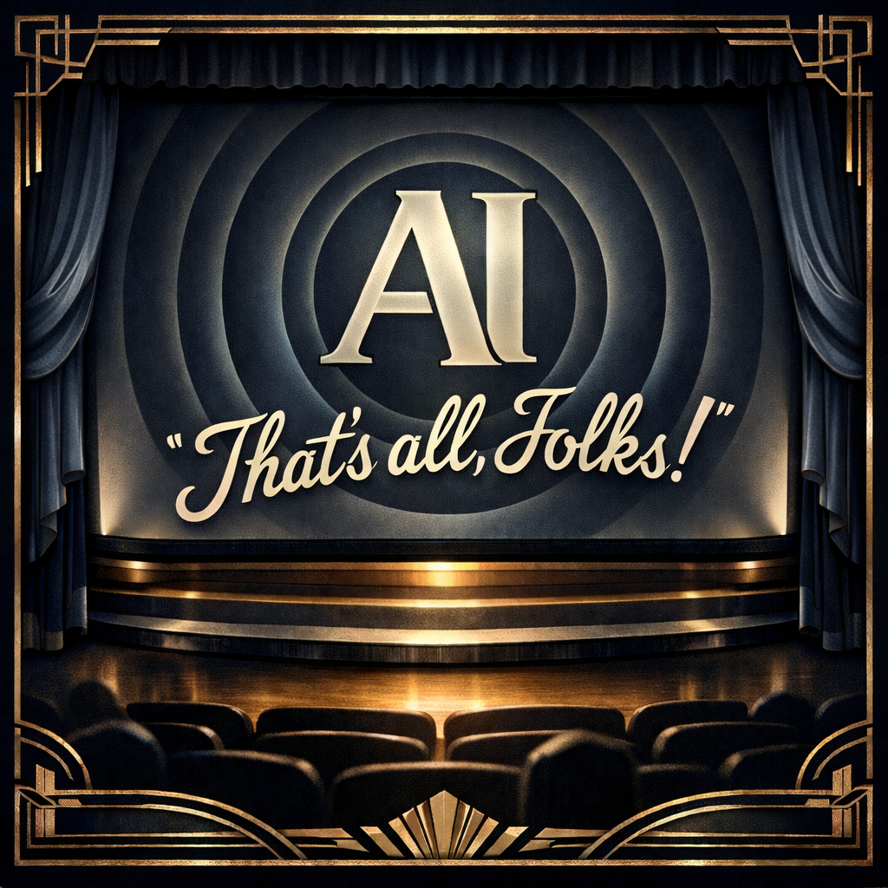
Thank You!
You can reach out at: Alessio.Azzutti@glasgow.ac.uk

